Slide 1


ECHELON’25
recr
uiterAI
Bridging the Gap between AI efficiency and human centric hiring!
TEAM: CodeVengers
Aarushi Jain- Frontend Developer
Ashok Thaniyath- Frontend Developer
Shravani Dhore- Backend Developer
Yash Patil- Backend Developer
NMIMS, Navi Mumbai

Slide 2

Problem Statement & Market Need
Self-Evolving Neuro-Symbolic AI for Fair & Future-Proof Hiring
Real-World Impact:
Revolutionizing hiring with an AI-driven, unbiased, and adaptive recruitment process that ensures fairness and efficiency.
Target Audience:
Revolutionizing hiring with an AI-driven, unbiased, and adaptive recruitment process that ensures fairness and efficiency.

Slide 3

An adaptive, bias-aware AI hiring assistant that empowers recruiters with fair, transparent, and intelligent hiring decisions.
RecruiterAI-
Key Features:
1
Job Description Creator
2
CV Analyser
3
AI-Powered Interviews
How Our Solution Addresses the Challenges:
Real-Time Learning – Our JD Generator adapts using OpenAI API, continuously refining job descriptions based on recruiter inputs.
Bias Reduction – AI-powered Virtual Interviews (OpenAI + Heygen API) eliminate human bias, ensuring fair assessments.
Explainable Decisions – The CV Analyzer provides a transparent skill-based ranking system with recruiter-defined weightages.
Recruiter Empowerment – HR managers can adjust AI decisions, fine-tune rankings, and analyze AI-driven candidate insights.

Slide 4
Job Description Creator
Form-based input system for structured job requirements.
OpenAI API integration to generate and refine job descriptions dynamically.
Continuous learning mechanism adapting to recruiter modifications for better accuracy.
CV Analyser
AI-powered CV parsing to extract and analyze skills from resumes.
Customizable weightage system for recruiters to refine AI-driven rankings.
Explainable AI logic ensuring transparency and fairness in selection.
AI Powered Interview
OpenAI API integration for generating intelligent, context-aware interview questions.
Heygen API-Powered avatars simulating realistic interviewer interactions.
Eliminates human bias by providing a consistent and objective AI-driven interview experience.

Slide 5
Target Market & Potential:
HR Tech companies, staffing agencies, job portals, EdTech, and government hiring.
Global AI recruitment market valued at $661.56M in 2023, projected to reach $1.12B by 2030 (CAGR 6.8%).
Rising demand for bias-free, automated, and scalable hiring.
Competitor Landscape
Competitors: HireVue, Pymetrics, LinkedIn Talent Hub.
Our Differentiation:
AI-Powered Interviews – Generative AI + Heygen avatar for unbiased, automated interviews.
Explainable CV Screening – AI with skill-based ranking and recruiter-defined weightage.
Real-Time JD Generator – AI learns dynamically from recruiter inputs.
Monetization & Revenue Model
SaaS Tiers – Startup, Growth, Enterprise.
Pay-Per-Use API – JD generation, CV analysis, AI interviews.
Enterprise Licensing & B2B Partnerships – HR platforms, EdTech, job portals.
Freemium Model – Basic features free, advanced AI via subscription.

Slide 6

Tech Stack & Implementation
Frontend
Backend
Job Description Creator: Fully functional prototype using OpenAI API to generate tailored JDs, served via Python backend and styled with HTML/CSS.
CV Analyzer: Beta version ranks resumes with 85% accuracy, leveraging OpenAI for text analysis, hosted on Azure.
AI-Powered Interview: powered by OpenAI and leveraged by Heygen API virtual avatar.
HTML & CSS for a responsive, user-friendly interface.
Python (Flask) for server-side logic and API integration.
GenAI
Azure
OpenAI API key for advanced NLP (job descriptions, CV analysis) and conversational AI (interviews)
Microsoft Azure for hosting, storage, and scalability.

Slide 7
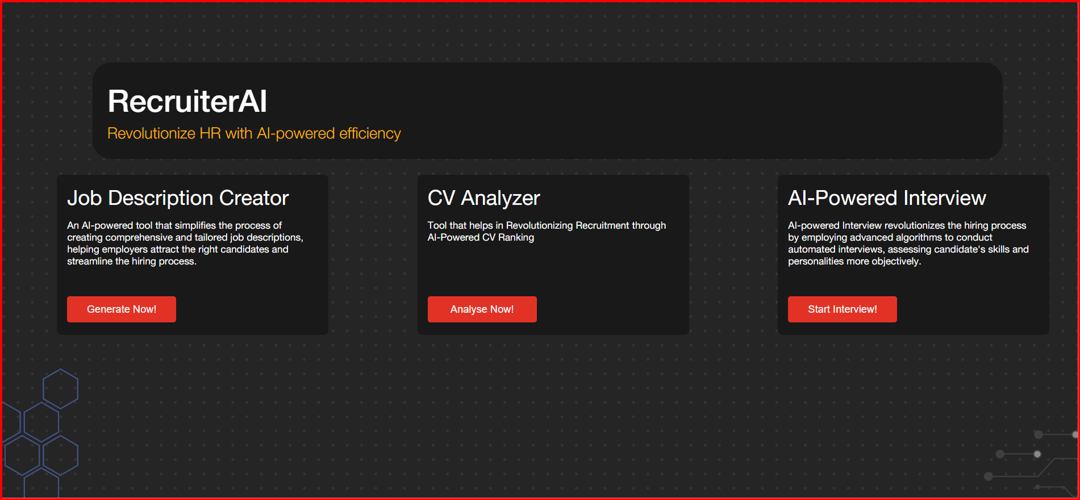

Application Interface
https://www.youtube.com/watch?si=qPA2hkKzpiVmFTrg&v=vhUd5ej8AM8&feature=youtu.be

Slide 8
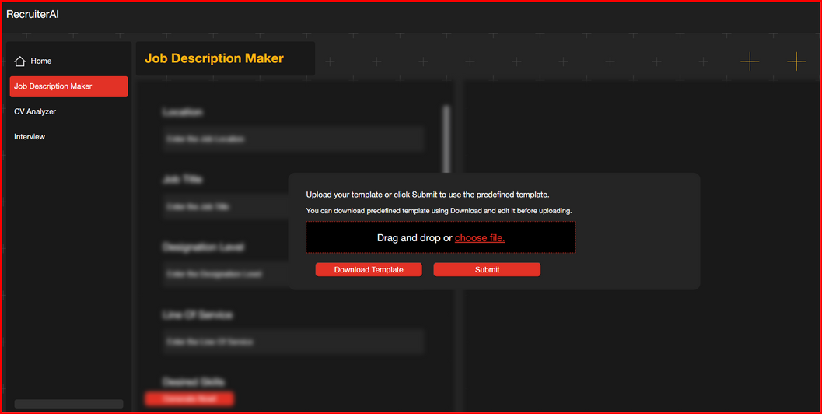
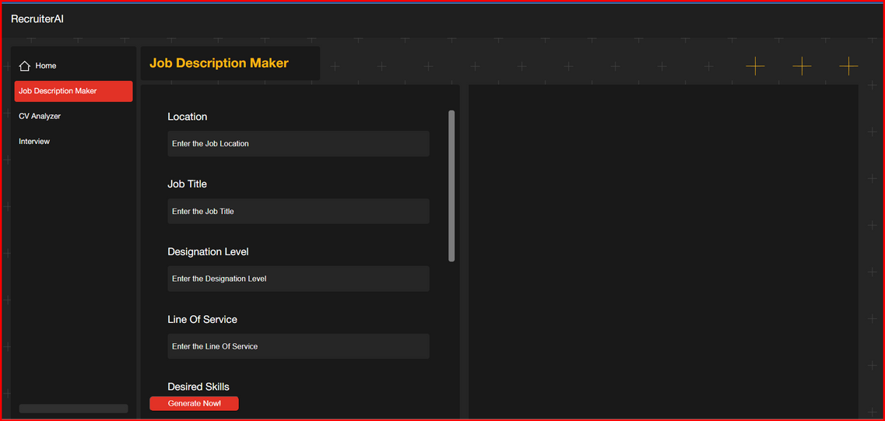
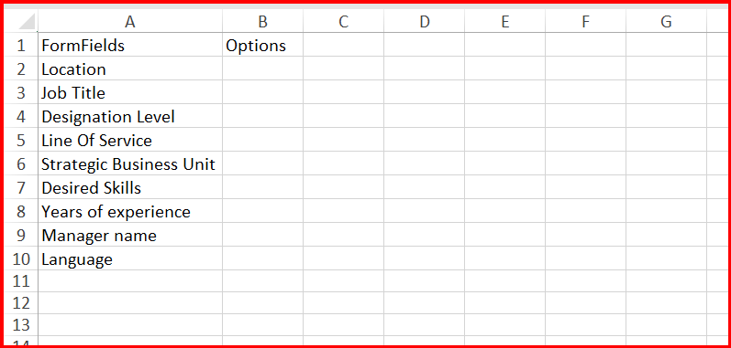
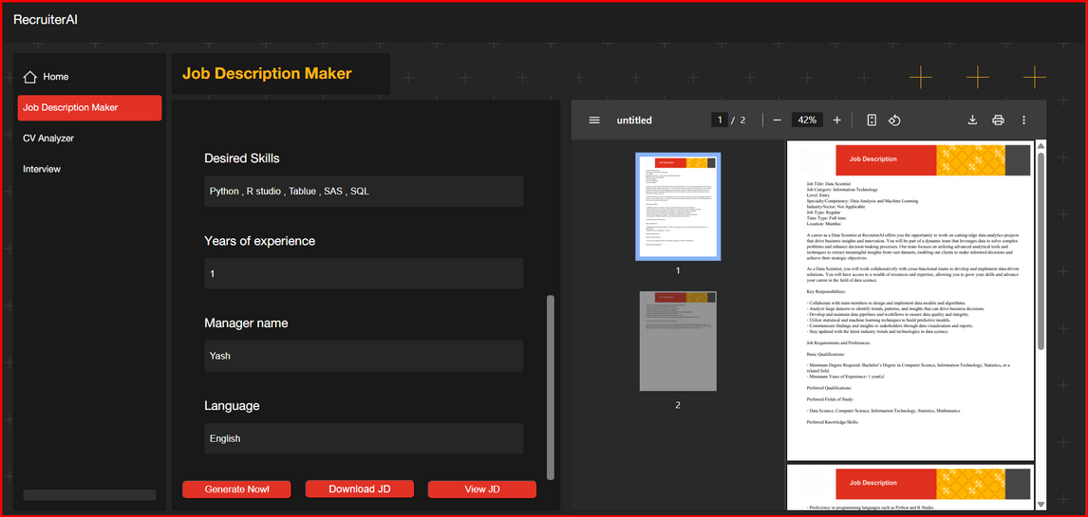
Application Interface

Slide 9
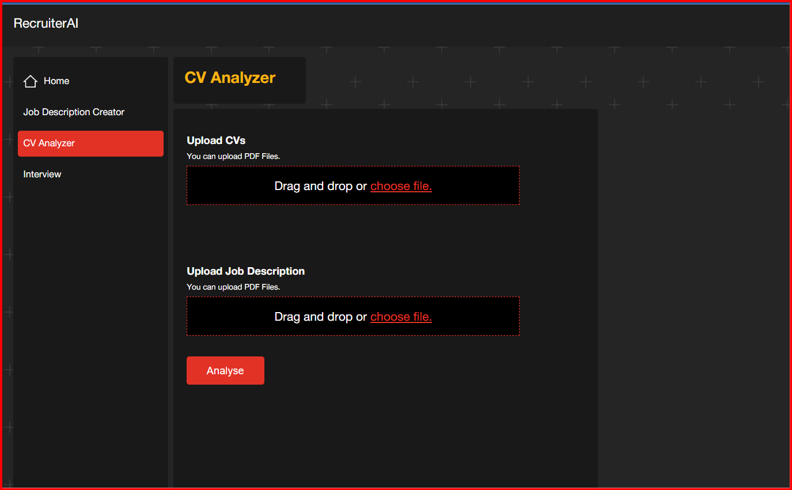
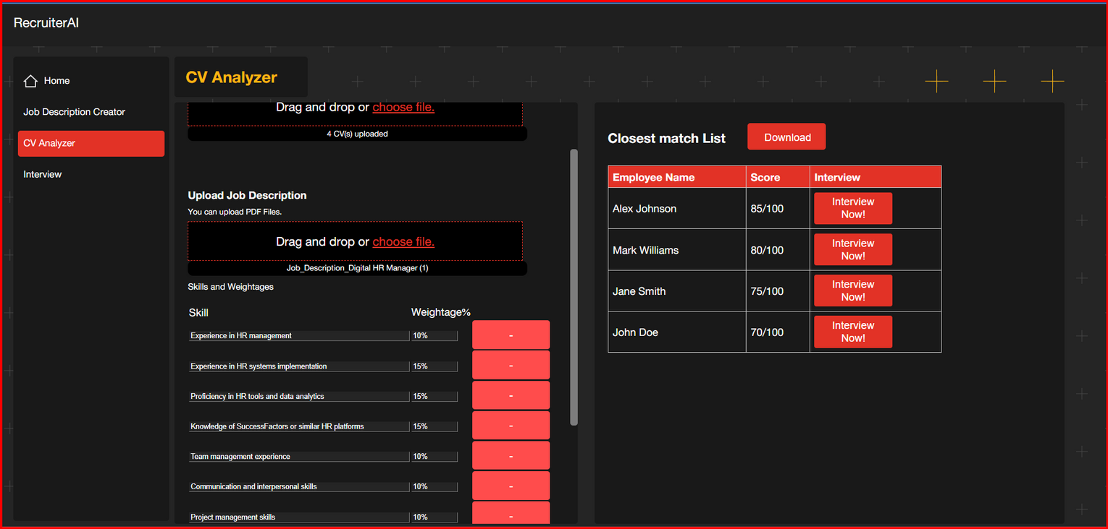
Application Interface

Slide 10
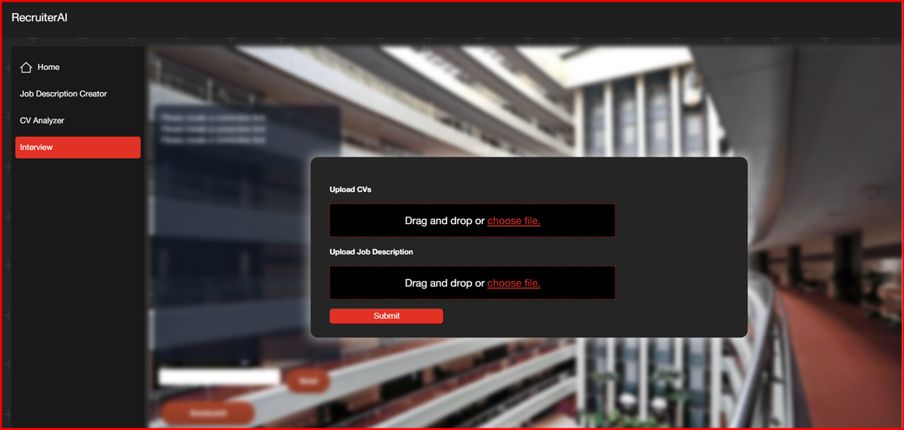
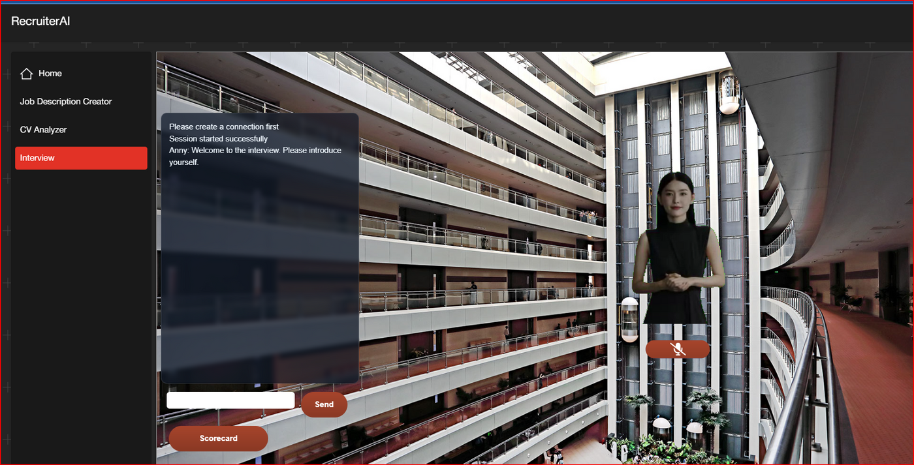
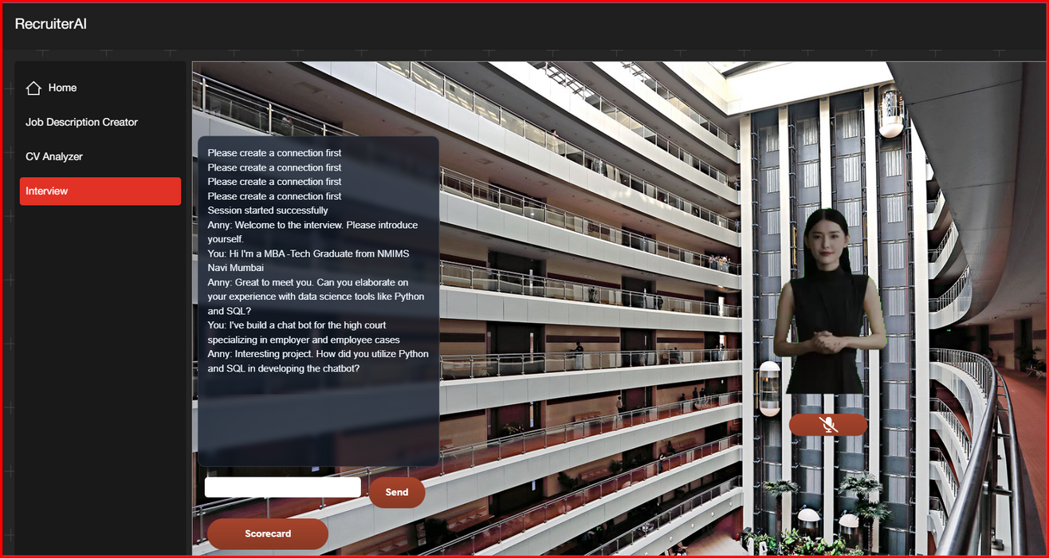
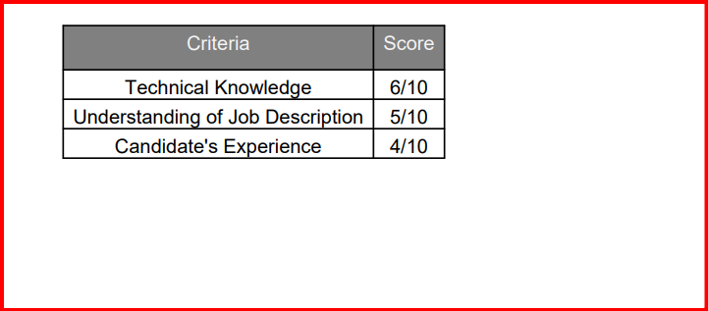

Slide 11

Future Scope & Scalability
AI-Powered Proctoring – Implement real-time monitoring in AI interviews to prevent impersonation and ensure candidate authenticity.
Multilingual AI Interviews – Expand interview capabilities to multiple languages, enabling global hiring and enhancing accessibility.

Slide 12
Innovative AI-Powered Hiring
AI-Powered Interviews with Virtual Avatars
Dynamic & Real-Time Learning
Scalable & Future-Ready
THANK YOU!

Slide 13
An adaptive, bias-aware AI hiring assistant that empowers recruiters with fair, transparent, and intelligent hiring decisions.
RecruiterAI-
Key Features:
Job Description Creator
1
AI-driven JD creation that adapts and improves in real time based on recruiter inputs.
CV Analyser
2
Smart CV shortlisting that ranks candidates based on weighted skills and transparent & explainable AI decisions.
AI-Powered Interviews
3
Virtual AI-driven interview avatars ensuring unbiased and standardized candidate assessments.

Slide 14

Use and Functionalities
Simple UI – Upload CVs, generate JDs, and conduct interviews seamlessly.
Customizable Hiring Flow – Adjust weightages, refine JD criteria, and review AI explanations.
Fast & Scalable – Automates bulk resume screening and shortlisting in seconds.
Use and Functionalities
Plug-and-Play – Easy integration into existing HR workflows.
Data-Driven Insights – Provides analytics for smarter hiring decisions.
Minimal Manual Effort – Reduces recruiter workload while improving accuracy.

Slide 15
